Slide 1

BLOCKCHAIN
NGUYỄN MINH LỘC
NGUYỄN TUẤN ĐẠT
DƯƠNG ĐÌNH TRUNG

Slide 2

01
ORIGIN
CONTENTS
02
DEVELOPMENT HISTORY
03
APPLICATIONS
04
POTENTIAL DEVELOPMENT

Slide 3
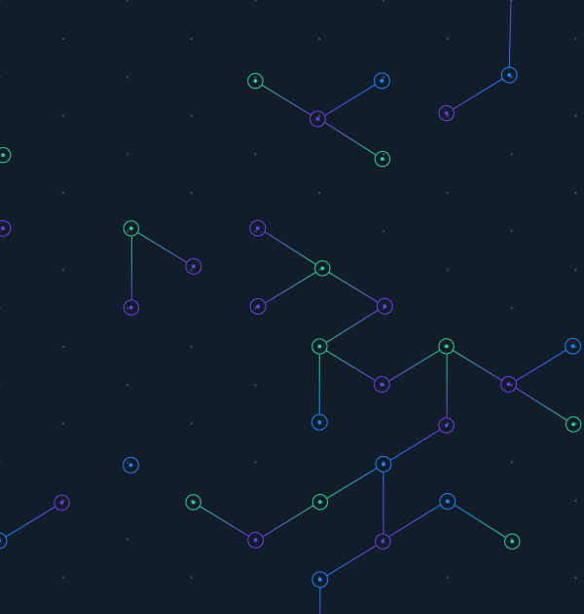

01
ORIGIN

Slide 4

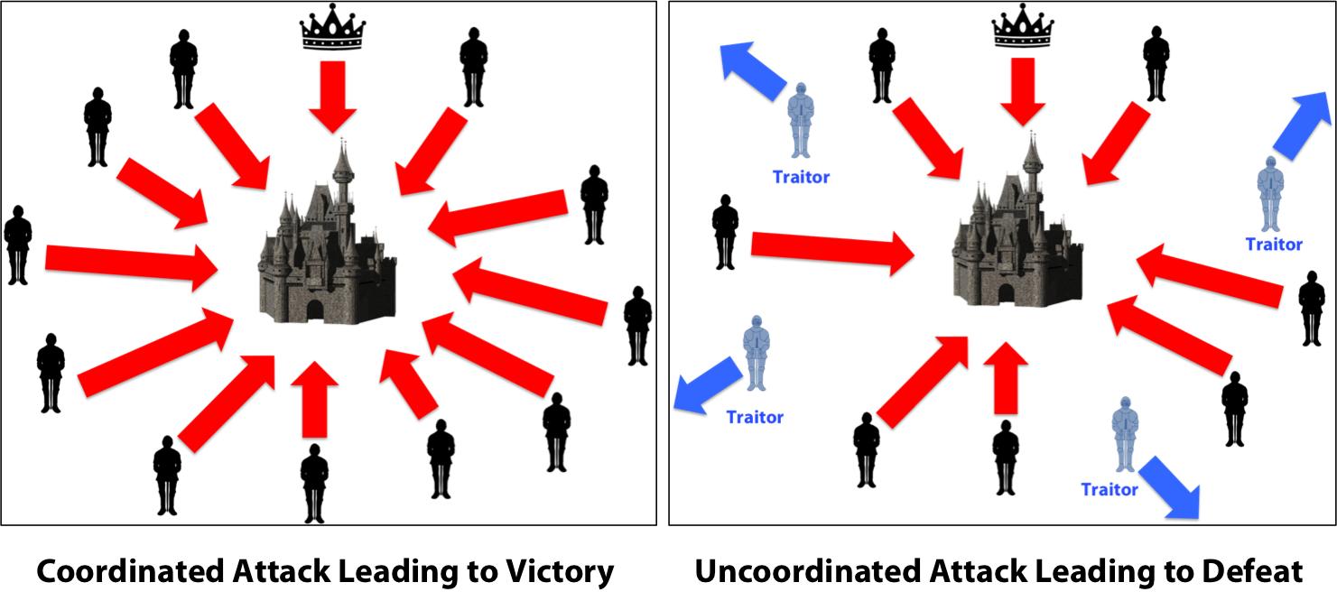

ORIGIN
BYZANTIME GENERALS
It’s derived from the problem of Byzantine Generals

Slide 5
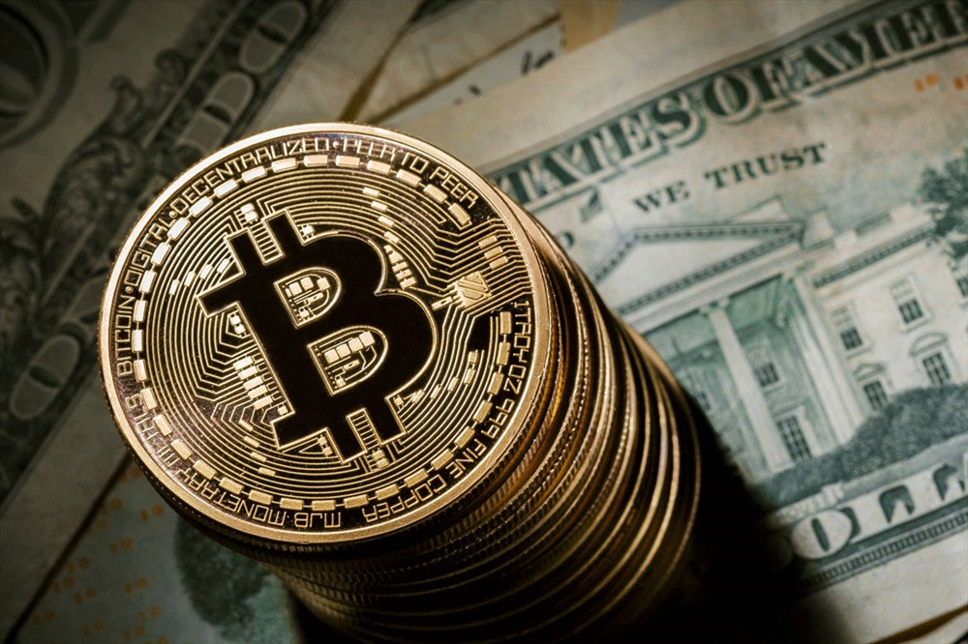
02
DEVELOPMENT
HISTORY

Slide 6
DEVELOPMENT HISTORY
BIT GOLD
BLOCK CHAIN
1982
1998
2008
2009
2015
CRYPTOGRAPHIC SIGNATURES
A PEER-TO PEER ELECTRONIC
CASH SYSTEM
ETHEREUM BLOCK CHAIN

Slide 7

03
APPLICATIONS

Slide 8
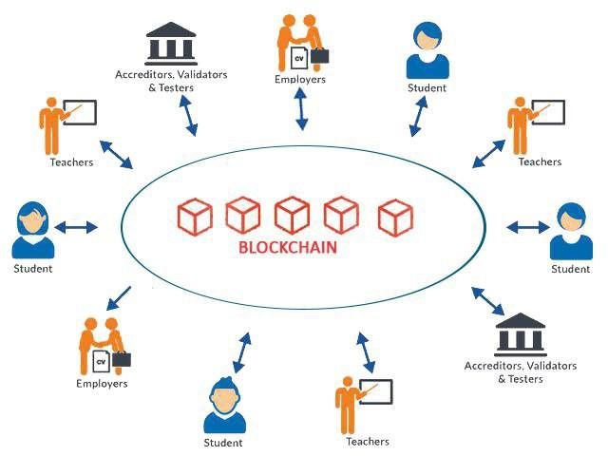


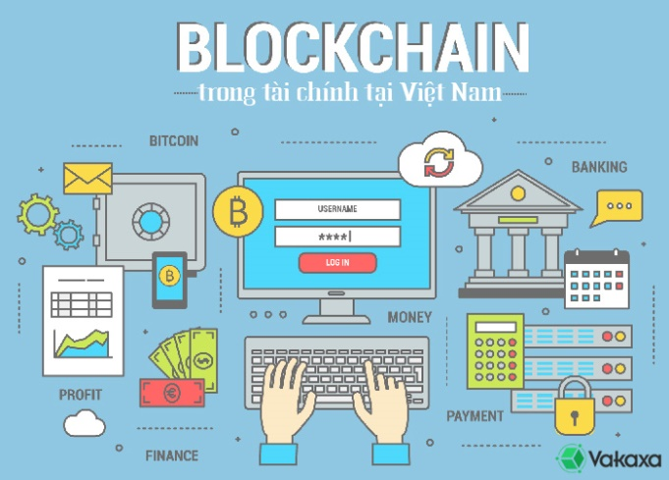
APPLICATIONS
EDUCATION
ECOMMERCE
HEALTHCARE
FINANCE

Slide 9

04
POTENTIALS

Slide 10
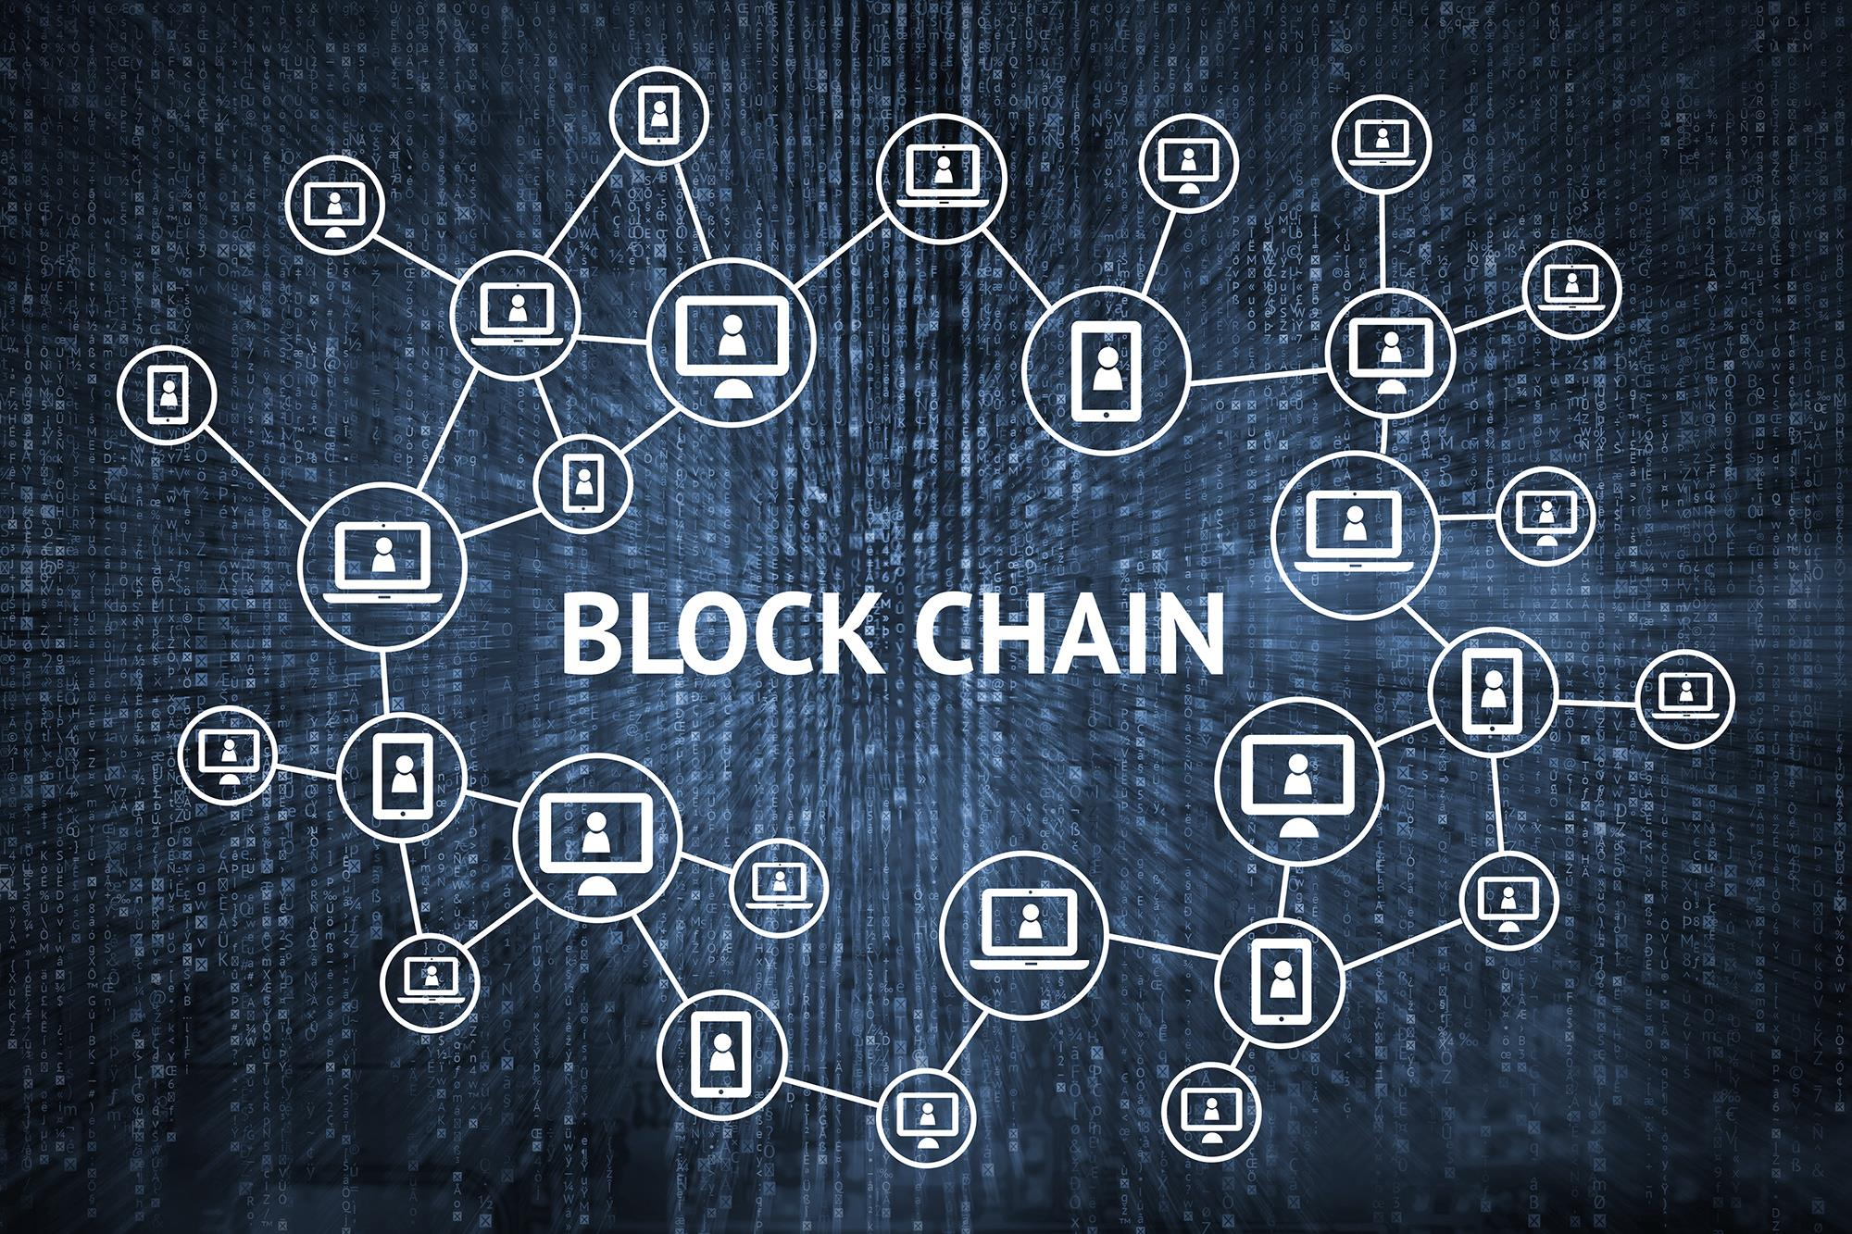
POTENTIAL DEVELOPMENT
NO DETAIL ORIENTATION
NEGATIVE PURPOSES
MANY
EMPLOYMENTS

Slide 11


THANK YOU
FOR
YOUR LISTENING

